Slide 1
Plan for cloud adoption
A plan is an essential requirement for a successful cloud adoption. A cloud adoption plan is an iterative project plan that helps a company transition from traditional IT approaches to transformation over to modern, agile approaches. This article series outlines how a cloud adoption plan helps companies balance their IT portfolio and manage transitions over time. Through this process, business objectives can be clearly translated into tangible technical efforts. Those efforts can then be managed and communicated in ways that make sense to business stakeholders. However, adopting such a process may require some changes to traditional project-management approaches.

Slide 2
Align strategy and planning
Cloud adoption plans start with a well-defined strategy. At a minimum, the strategy should outline the motivations, business outcomes, and business justifications for cloud adoption. Those positive returns are then balanced by the effort required to realize them.
The effort starts with the digital estate (proposed or existing), which translates the strategy into more tangible workloads and assets. You can then map these tangible elements to technical work. From there, skilled people in a proper organizational structure can execute the technical work. The cloud adoption plan combines these topics into one plan that can be forecasted, budgeted, implemented, and managed by means of agile project-management practices. This article series helps you build the plan and provides a few templates to make the job easier.

Slide 3
Transition from sequential to iterative planning
Planning for cloud adoption can be a significant change for some organizations. IT organizations have long focused on the application of linear or sequential models of project management, like the waterfall model. In traditional IT, this approach was entirely logical. Most large IT projects started with a procurement request to acquire expensive hardware resources. Capital expense requests, budget allocations, and equipment acquisition often represented a large percentage of project execution. And after it was acquired, the hardware itself became a constraint on what could be delivered.
The acquisition models of the cloud change the core dependencies that made a sequential model necessary. The replacement of acquisition cycles with an operating-expense approach helps businesses move more quickly and with smaller financial commitments. This approach helps teams to engage in projects before all requirements are well known. It also creates room for a growth mindset, which frees the team to experiment, learn, and deliver without artificial constraints. For all these reasons and more, we highly recommend that teams use agile or iterative approaches to cloud adoption planning.

Slide 4
Build your cloud adoption plan
This article series walks through each step of translating strategy and effort into an actionable cloud adoption plan:
Prerequisites: Confirm that all prerequisite steps have been completed before you create your plan.
Define and prioritize workloads: Prioritize your first 10 workloads to establish an initial adoption backlog.
Align assets to workloads: Identify which assets (proposed or existing) are required to support the prioritized workloads.
Review rationalization decisions: Review rationalization decisions to refine adoption path decisions: migrate or innovate.
Establish iterations and release plans: Iterations are the time blocks allocated to do work. Releases are the definition of the work to be done before triggering a change to production processes.
Estimate timelines: Establish rough timelines for release planning purposes, based on initial estimates.

Slide 5
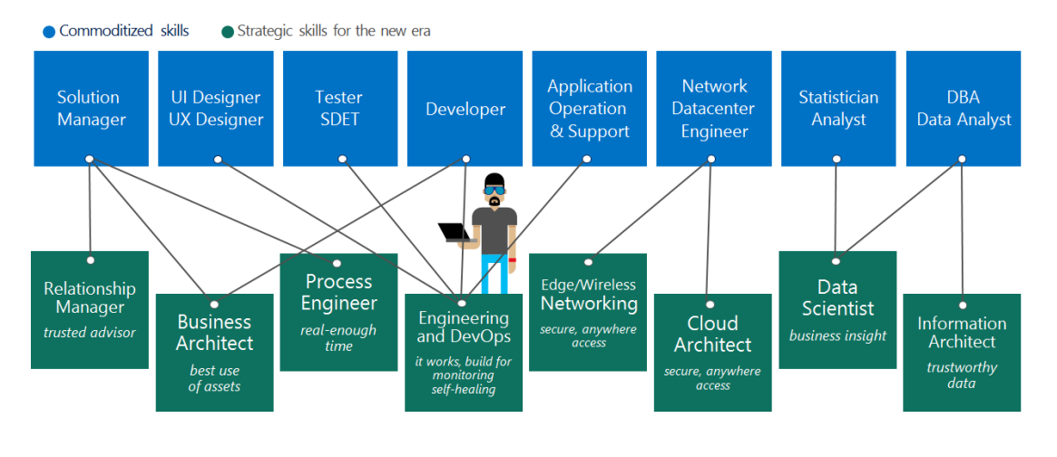
Get started on a skills readiness path
As more organizations embrace cloud solutions, IT professionals might feel anxious about their roles. Cloud technologies require a different set of skills. However, learning these new skills doesn't have to be hard. With the right training, you can gain the expertise and confidence to help your organization understand and embrace the changing technology landscape.

